Slide 1
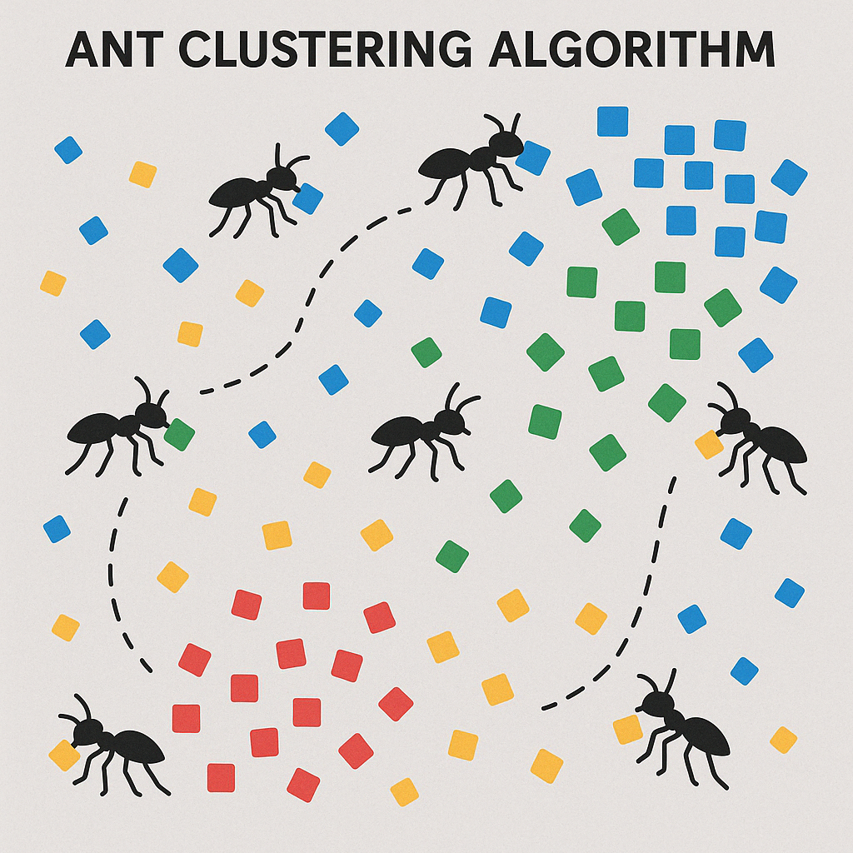
Ant Clustering Algorithm
Instructor:
Dr. Luis Rocha
Presented by:
Kiet Ngo Tuan
Emad Abed
April 2025

Slide 2
How can Ants inspire us to look at things in a simpler way?

Slide 3
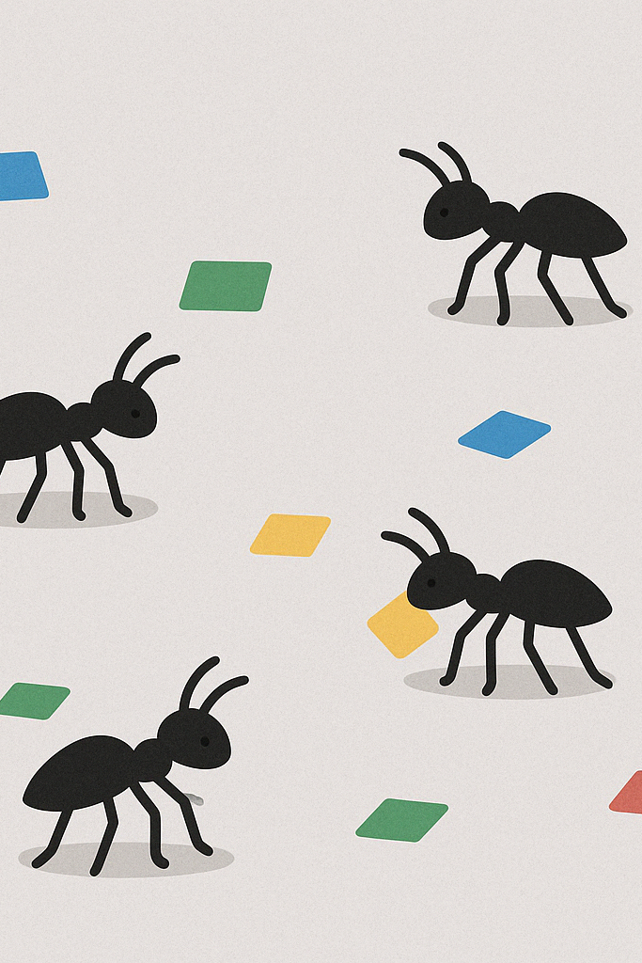
🐜 What is the Ant Clustering Algorithm?
Imagine a bunch of ants walking around on a floor. Scattered on the floor are objects
The ants don’t know what the objects are (Similarity is the only thing they understand)
Each ant:
Can pick up or drop an object.
Makes that decision by looking at how similar nearby objects are.
Ants “organize” similar items into clusters, just like they do with dead ants in nature.

Slide 4
What is the simple Idea behind it?
Like most of the concepts we have had in this course:
Ants follow very simple rules:
“If I see a bunch of things similar to what I’m carrying, I’ll drop it.”
“If I’m not carrying anything and I see something unusual, I might pick it up.”

Slide 5
How it mathematically works?
$P_{p}\left(f\right)={\left(\frac{k_{1}}{k_{1}+f\left(i\right)}\right)}^{2}$
Imagine:
𝑓(𝑖) : is the similarity fraction
k1​: is a constant
If 𝑓(𝑖) is small → ?
If 𝑓(𝑖) is large → ?
What if we replace K and 𝑓(𝑖) in the formula?

Slide 6
How it mathematically works?
$P_{p}\left(f\right)={\left(\frac{k_{1}}{k_{1}+f\left(i\right)}\right)}^{2}$
Imagine:
𝑓(𝑖) : is the similarity fraction
k1​: is a constant
If 𝑓(𝑖) is small → (neighborhood is dissimilar), then 𝑃𝑝​ is high →pick it up!
If 𝑓(𝑖) is large (many similar items nearby), then 𝑃𝑝 is low → don’t pick up!

Slide 7
How it mathematically works?
$P_{d}\left(f\right)={\left(\frac{f\left(i\right)}{k_{2}+f\left(i\right)}\right)}^{2}$
Imagine:
𝑓(𝑖) : is the similarity fraction
k2​: is a constant
If 𝑓(𝑖) is small → (neighborhood is dissimilar) → not enough similar items → low chance of dropping
If 𝑓(𝑖) is large (many similar items nearby) → lots of similar items → high chance of dropping

Slide 8
What we discussed in a glance
Situation | Perceived Similarity $f\left(i\right)$ | Pickup Prob. $P_{p}\left(f\right)$ | Drop Prob. $P_{d}\left(f\right)$
Surrounded by dissimilar | Low | High | Low
Surrounded by similar | High | Low | High

Slide 9
Similarity is what we are looking for
Data Vector X_{i}
Data Vector X_{j}
X_{i,1} | X_{i,2} | X_{i,3} | … | X_{i,n}
X_{j,1} | X_{j,2} | X_{j,3} | … | X_{j,n}
$$D\left(x_{i},x_{j}\right)=\sqrt{\sum_{k=1}^{n}{{\left(x_{i,k}−x_{j,k}\right)}^{2}}}$$

Slide 10
Projecting Attribute Vectors into 2D Space
Ants don't live in multi-dimensional space. They move around on a 2D grid (like a chessboard).
So, we map each object from its feature vector to a location on the 2D grid where the simulation happens. This doesn’t change the object's attributes, just its location in the virtual ant world.

Slide 11
2 | 3
 | 4
 | 5
[2,1]
 | [4,1] | [3,6]
[5,4]
Squares could be 3 by 3, 5 by 5 etc

Slide 12
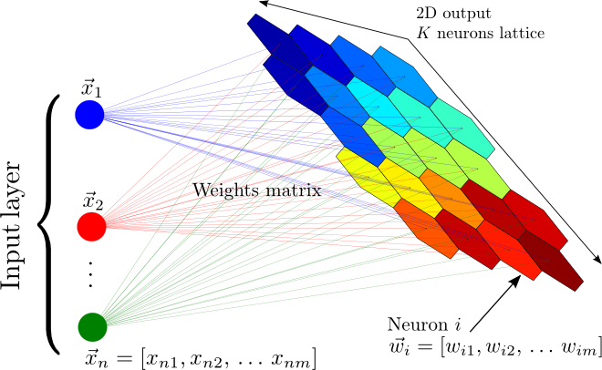
SOM Kohonen map
Pick a random data point.
Find the Best Matching Unit (BMU) — the neuron whose weight vector is closest to the data point.
Update the BMU and its neighbors to become more like the data point.

Slide 13
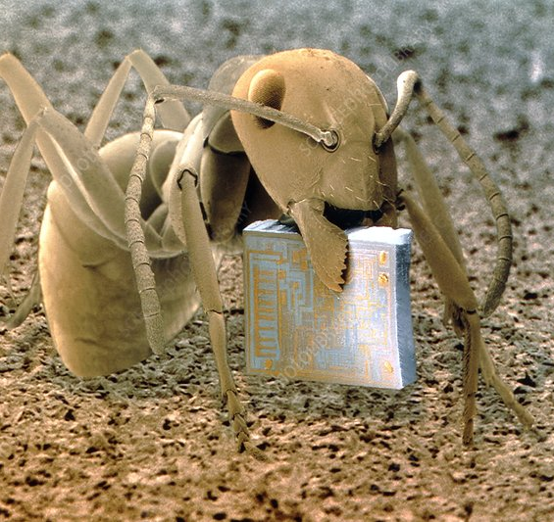
But what ants do is simpler…
Two Simple rules:
Pick up objects if they look out of place.
Drop objects where similar ones are nearby.
Each ant is like a tiny computer following simple rules — that’s what’s meant by a cellular automaton.

Slide 14
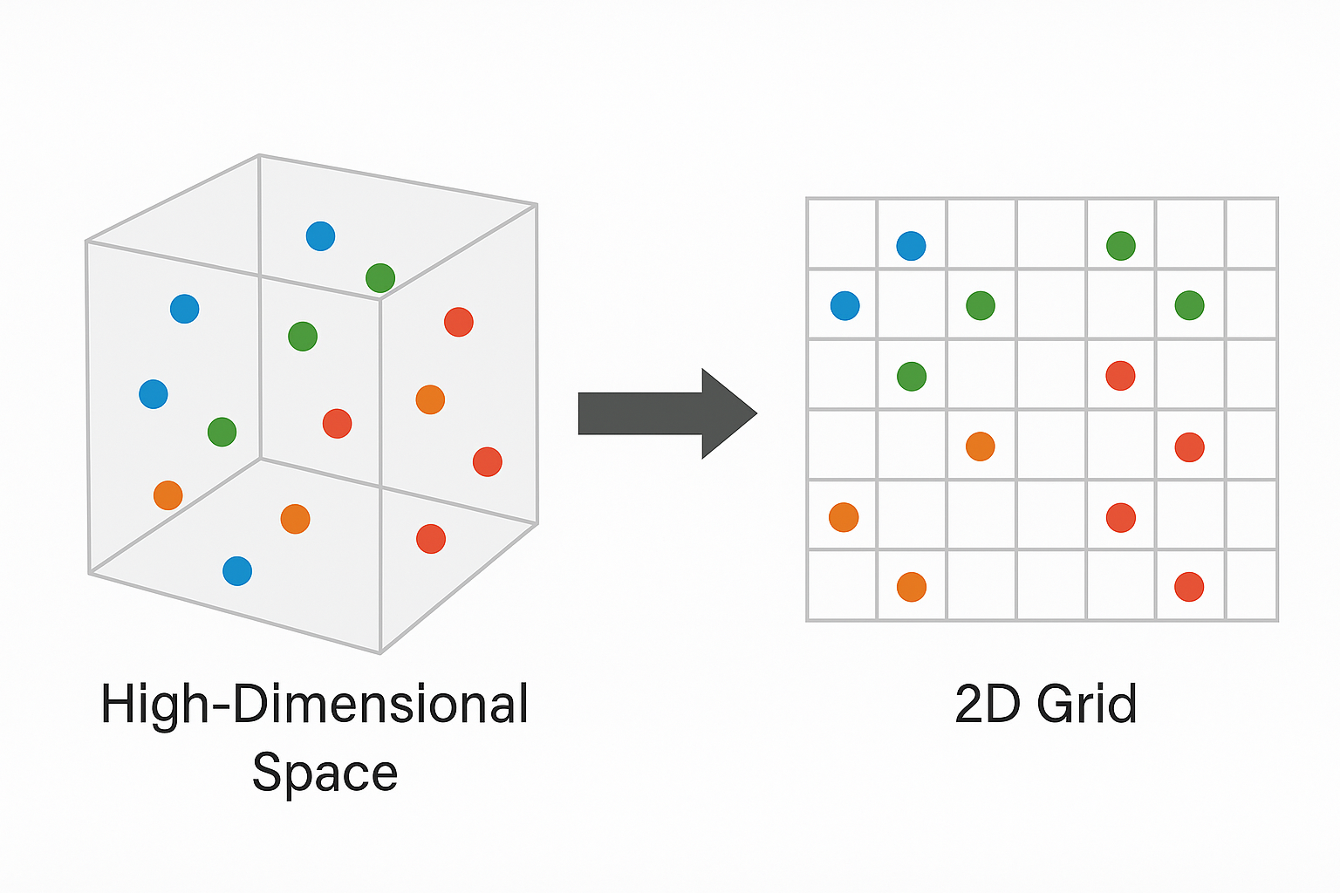
Dimensionality Reduction
Is ACA a dimensionality reduction algorithm? | ❌ No
Does ACA need dimensionality reduction to work? | ✅ Yes, it works in 2D

Slide 15
Applications of ACA
Where can we use this algorithm?

Slide 16
EDA (Exploratory Data Analysis)
🔹 Step 1: Project High-Dimensional Data into 2D Grid
Project feature-rich data onto a 2D grid, so ants can walk around and manipulate it.
🔹 Step 2: Drop Random Objects on Grid
The input data (e.g., documents, customer records, images) is randomly scattered on the grid.

Slide 17
EDA (Exploratory Data Analysis)
🔹 Step 3: Let Ants Roam and Cluster
Each ant:
Walks randomly
Picks up isolated or out-of-place items
Drops them near similar items
🔹 Step 4: Visually Inspect the Grid
Analyze cluster shapes
Spot outliers or transition zones
Interpret regions where ants placed similar items together

Slide 18
How to Implement the Algorithm?
Let's check out the Notebook:
Play with the parameters:
Number of Ants
Number of Items
Size of the grid
Speed of Ants

Slide 19
Some mathematical definitions
To calculate the local density of items near $x_{i}.$
f($x_{i}$):
$\frac{1}{S^{2}}\sum_{x_{j}∈\text{Neigh}\left(x_{i}\right)\left(r\right)}{\left[1−\frac{d\left(x_{i},x_{j}\right)}{α}\right]}$ if f>0
0 Otherwise

Slide 20
About the previous slide
Symbol | Meaning | Role in ACA
f($x_{i}$) | Average similarity of item ​ to its neighbors | Guides pickup and drop decisions
α | Scale of dissimilarity | Controls how strict the similarity check is
$$d\left(x_{i},x_{j}\right)$$ | Distance between two items | Calculated in original data space, not grid for similarity checking

Slide 21
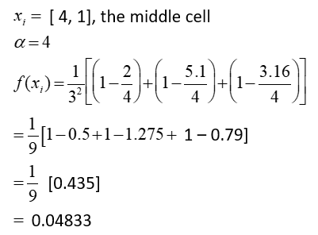
Example: f(x_{i}) for a single data item
[2,1]
 | [4,1] | [3,6]
[5,4]
Notes:
f(xi) = Sum of similarities.

Slide 22
Updated pickup and drop possibilities
$p_{p}\left(x_{i}\right)={\left(\frac{k_{1}}{k_{1}+f\left(x_{i}\right)}\right)}^{2}$
$p_{d}\left(x_{i}\right)=2 ∗f\left(x_{i}\right) if f\left(x_{i}\right)$ < $k_{2}$
$p_{d}\left(x_{i}\right)=$1 Otherwise

Slide 23
Too Many Clusters !
Problem: In traditional ACA, once a cluster forms, it tends to stay even if the cluster was built incorrectly. Weak clusters can survive just because ants don't destroy them.
Solution:
Behavioral Switch:
Ants are given the ability to destroy clusters that are not properly reinforced.
If a cluster hasn’t been reinforced (no new similar items added) for a long time, ants break apart the cluster.

Slide 24
Improvements to ACA
🐜🔍Problem:
Standard ACA often creates too many clusters. 🧩❗
Solutions Proposed:
Cooling schedule for 𝑘1❄️⏳→ Gradually decreases 𝑘1​ over time to stabilize decisions.
Progressive vision field 🔭👀→ Ants slowly see a wider area, helping them detect larger clusters better.
Pheromone reinforcement 🧪🐜→ Encourages ants to drop items where other similar items are already located, strengthening good clusters.

Slide 25
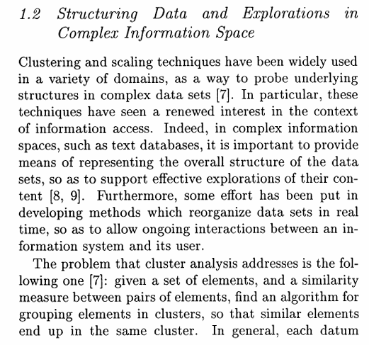
Cluster analysis: Problem
Given a set of elements and similarity measure, find an algorithm for grouping elements in clusters
Similar elements end up in the same cluster
Each datum be represented as a point in space
The true number of clusters is unknown
Lumer, E. D. and Faieta, B. 1994. Diversity and adaptation in populations of
clustering ants. In From Animals To Animats3, pp. 501-508.

Slide 26
Grooming an ant colony
Result = dead ants collected in one or a few places.
Collecting dead ants together -
If you are not already carrying a dead ant, and you bump into one, pick it up if you see few other dead ants in that area.
If you are carrying a dead ant, drop it if you see many other dead ants in that area.
Dead ant that needs to be segregated
Live ant that wanders and segregates dead ants

Slide 27
Notes:
Two types of dead ants – green and blue

Slide 28
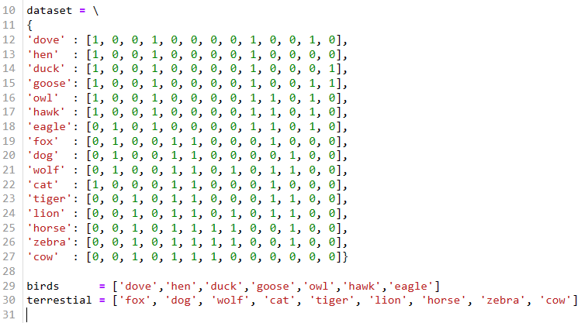
Question 3
In case of animals, you calculate the similarity between the animal you want to pick up or drop and of those in that area.
Let's check out the Notebook for Final results that you get.
From dataset.py

Slide 29
Ant Clustering Algorithm summarized
Create a R x C grid
Strew your data points across the grid
Randomly place N ants in the grid, with no more than one ant occupying a cell
Do the following for a given maximum number of iterations:
For every ant in the grid, in their respective cells:
If ant is not carrying a data point and its cell contains one, x_{i}, then
Compute f(x_{i})
Pick up item with probability P_{p}(x_{i})
If ant is carrying a data point x_{i} and its cell is free, then
Compute f(x_{i})
Drop item with probability P_{d}(x_{i})
Walk ant to a random neighboring cell that is not occupied by another ant
Notes:
The cell an ant can walk to should only not contain another ant, but can of course contain data points -- that’s how the ant sorts them out, by picking-up or dropping the data point in the cell where it is standing.

Slide 30
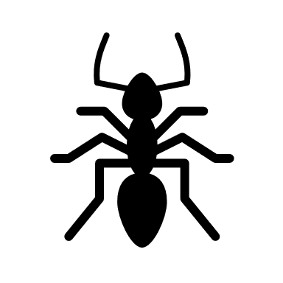
Thanks a lot for your attention

